Slide 1
Data Structures
ICT-1211
Information and Communication Technology
Lecture-02
Date:

Slide 2
Introduction

Slide 3
Data Structure Operations
The data appearing in our data structure are processed by mean of certain operations.
The most frequently used of these operation are:
Traversing
Searching
Inserting
Deleting
Update
Sorting
Merging

Slide 4
Data Structure Operations
Accessing each record once so that certain items in the record may be processed (Visit).
Example:
An organization contains a membership file in which each record contains data for a given member:
Name Address Tel. Number Age Sex
Suppose the organization wants to announce through a mailing.
Suppose one wants to find the name of all members in a certain area.
Operation: Traversing

Slide 5
Data Structure Operations
Finding the location of the record with a given key value, or finding the locations of all records which satisfy one or more condition.
Example:
An organization contains a membership file in which each record contains data for a given member:
Name Address Tel. Number Age Sex
Suppose one wants to obtain address for a given name.
Operation: Searching

Slide 6
Data Structure Operations
Adding a new record to the structure
Example:
An organization contains a membership file in which each record contains data for a given member:
Name Address Tel. Number Age Sex
Suppose a new person joins the organization.
Operation: Inserting

Slide 7
Data Structure Operations
Removing a record from the structure
Example:
An organization contains a membership file in which each record contains data for a given member:
Name Address Tel. Number Age Sex
Suppose a Member dies.
Operation: Deleting

Slide 8
Data Structure Operations
Changing items in the record with the new data
Example:
An organization contains a membership file in which each record contains data for a given member:
Name Address Tel. Number Age Sex
Suppose a member has moved and has a new address and telephone number.
Operation: Updating

Slide 9
Data Structure Operations
Arranging the record in some logical order (e.g. alphabetically according to some NAME key)
Example:
An organization contains a membership file in which each record contains data for a given member:
NAME Address Tel. Number Age Sex
Suppose One wants to obtain all the members list according to alphabetical order of their family name.
Operation: Sorting

Slide 10
Data Structure Operations
Combining the records in two different sorted files into a single sorted file.
Example: Exam Answer Script
Operation: Merging

Slide 11
Algorithms ?
An algorithm is a well-defined list of step for solving problem.
The efficiency of an algorithm is obtained by measuring the TIME and SPACE it uses.

Slide 12
Algorithms Notation
(Largest Element in Array) A nonempty array DATA with N numerical values is given. This algorithm finds the location LOC and the value MAX of the largest element of DATA. The variable K is used as counter.
Step 1. [Initialize] Set K:=1, LOC:=1 and MAX := DATA[1].
Step 2. [Increment counter.] Set K:=K+1.
Step 3. [Test counter.] If K>N, then:
      Write: LOC, MAX, and Exit.
Step 4. [Compare and update.] If MAX<DATA[K], then:
Set LOC:=K and MAX := DATA[K].
Step 5. [Repeat loop.] Go to Step 2.

Slide 13
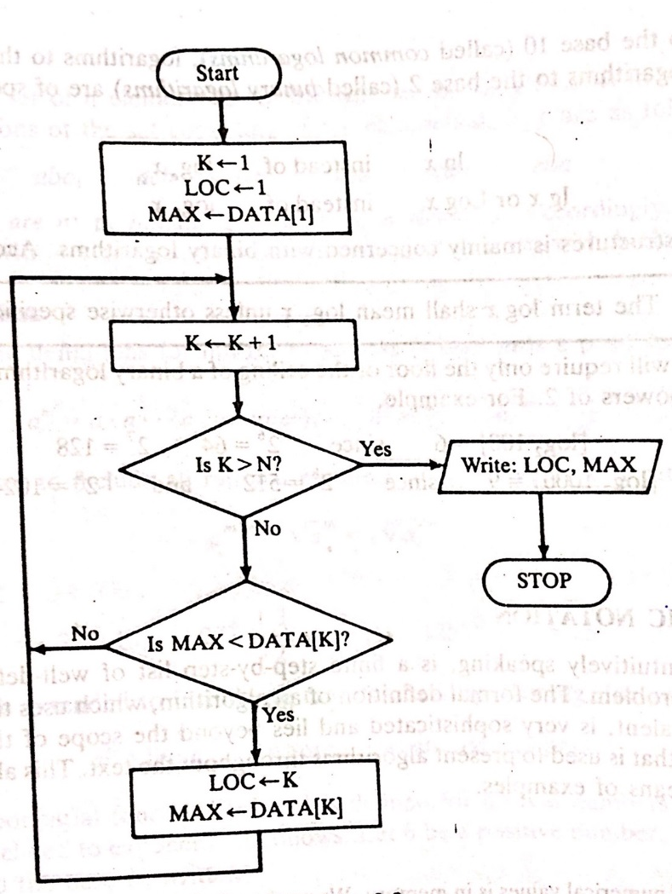
Flowcharts

Slide 14
Algorithms Notation
(Largest Element in Array) A nonempty array DATA with N numerical values is given. This algorithm finds the location LOC and the value MAX of the largest element of DATA. The variable K is used as counter.
Step 1. [Initialize] Set K:=1, LOC:=1 and MAX := DATA[1].
Step 2. [Increment counter.] Set K:=K+1.
Step 3. [Test counter.] If K>N, then:
      Write: LOC, MAX, and Exit.
Step 4. [Compare and update.] If MAX<DATA[K], then:
Set LOC:=K and MAX := DATA[K].
Step5. [Repeat loop.] Go to Step 2.
The Steps of the algorithm are executed one after the other, beginning with Step 1
Control may be transferred to Step n of the algorithm by the statement “Go to Step n”
If several statements appear in the same step, e.g.,
          Set K:=1, LOC:=1 and MAX := DATA[1].
          then they are executed from LEFT TO RIGHT
The algorithm is completed when the statement
            Exit. Is encountered.

Slide 15
Algorithms Notation
(Largest Element in Array) A nonempty array DATA with N numerical values is given. This algorithm finds the location LOC and the value MAX of the largest element of DATA. The variable K is used as counter.
Step 1. [Initialize] Set K:=1, LOC:=1 and MAX := DATA[1].
Step 2. [Increment counter.] Set K:=K+1.
Step 3. [Test counter.] If K>N, then:
      Write: LOC, MAX, and Exit.
Step 4. [Compare and update.] If MAX<DATA[K], then:
Set LOC:=K and MAX := DATA[K].
Step5. [Repeat loop.] Go to Step 2.
The [comment] will usually appear at the beginning or the end of the step.
Variable names will use capital letters as in MAX and DATA.
    Single-letter names of variables used as counters or subscripts will also be capitalized in the algorithms (K and N, for example).

Slide 16
Algorithms Notation
(Largest Element in Array) A nonempty array DATA with N numerical values is given. This algorithm finds the location LOC and the value MAX of the largest element of DATA. The variable K is used as counter.
Step 1. [Initialize] Set K:=1, LOC:=1 and MAX := DATA[1].
Step 2. [Increment counter.] Set K:=K+1.
Step 3. [Test counter.] If K>N, then:
      Write: LOC, MAX, and Exit.
Step 4. [Compare and update.] If MAX<DATA[K], then:
Set LOC:=K and MAX := DATA[K].
Step5. [Repeat loop.] Go to Step 2.
Assignment statements will use the dots-equal notation (:=).
  For example, MAX := DATA[1]. ( Some time ← or = is used for this operation
Data may be input and assigned to variables by means of a Read statement
    For example, Read: Variable names
Similarly, data in variable may be output by mean of a Write or Print statement
    For example, Write: Message and / or variable names.

Slide 17
Complexity of Algorithms
The complexity of an algorithm is the function which gives the running time and/or space in terms of the input size.
In order to compare algorithms, we must have some criteria to measure the efficiency of a algorithm.
Suppose M is an algorithm, and suppose n is the size of the input data.
The TIME and SPACE used by the algorithm M are the two main measures for the efficiency of M.
The TIME is measured by counting the number of key operation-in sorting and searching algorithms. (the # of comparison)
The SPACE is measured by counting the maximum of memory needed by the algorithm

Slide 18
Thank you……

